Slide 1
Unit - 4
The Medium Access Control Sub layer
Prachi Shah
IT Dept.
BVM

Slide 2
Contents
1. | Channel Allocation | [From Attached PDF]
2. | Multiple Access Protocols | [From Forouzan Ch-12]
3. | Ethernet | [From Forouzan Ch-13]
4. | Data Link Layer Switching : Bridges, local Internetworking, Spanning tree bridges, Remote Bridge, Repeaters, Hub, Switches, routers, Gateway | [From Attached PDF as well as Forouzan Ch-15]
5. | Virtual LANs | [From Attached PDF]

Slide 3
The Channel Allocation Problem
Static Channel Allocation in LANs and MANs
Dynamic Channel Allocation in LANs and MANs

Slide 4
Dynamic Channel Allocation in LANs and MANs
Station Model.
Single Channel Assumption.
Collision Assumption.
(a) Continuous Time. (b) Slotted Time.
(a) Carrier Sense. (b) No Carrier Sense.

Slide 5
Multiple Access Protocols
ALOHA
Pure ALOHA
Slotted ALOHA
Carrier Sense Multiple Access (CSMA)
CSMA/CD
CSMA/CA

Slide 6
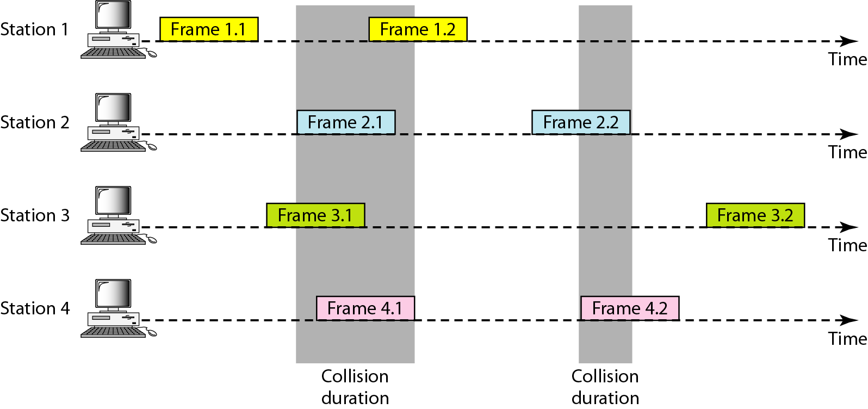
Figure 12.3 Frames in a pure ALOHA network

Slide 7
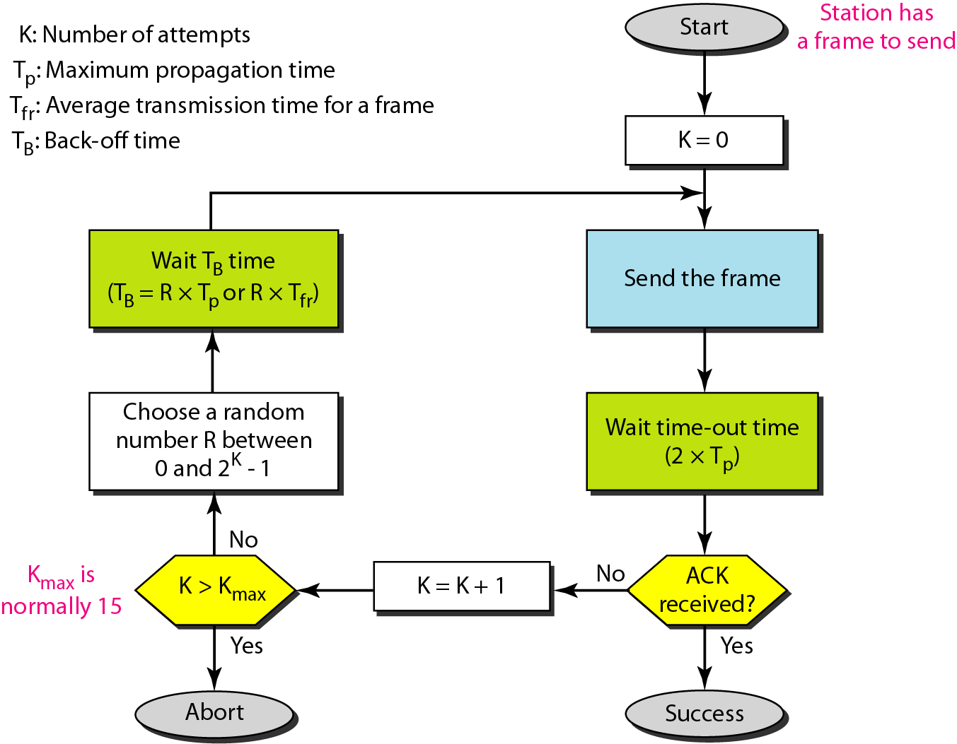
Figure 12.4 Procedure for pure ALOHA protocol

Slide 8
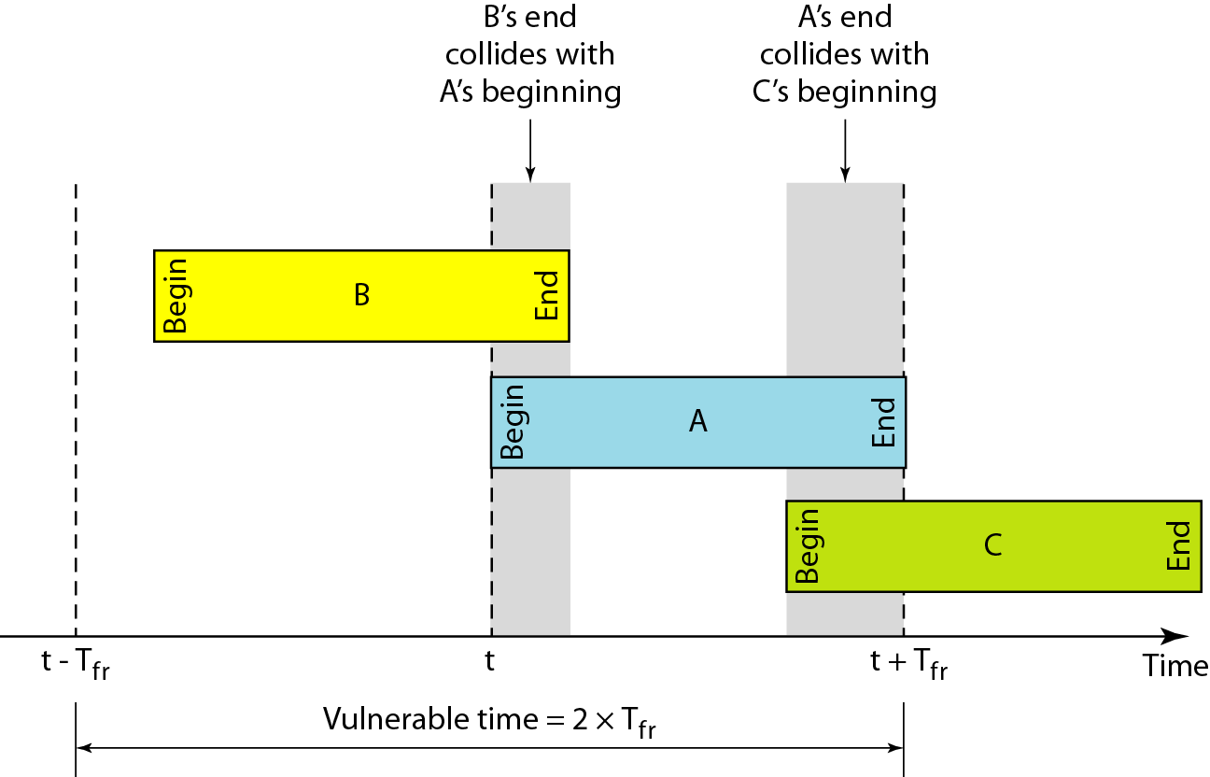
Figure 12.5 Vulnerable time for pure ALOHA protocol

Slide 9

Note
The throughput for pure ALOHA is S = G × e ^{−2G} .
The maximum throughput
S_{max} = 0.184 when G= (1/2).

Slide 10
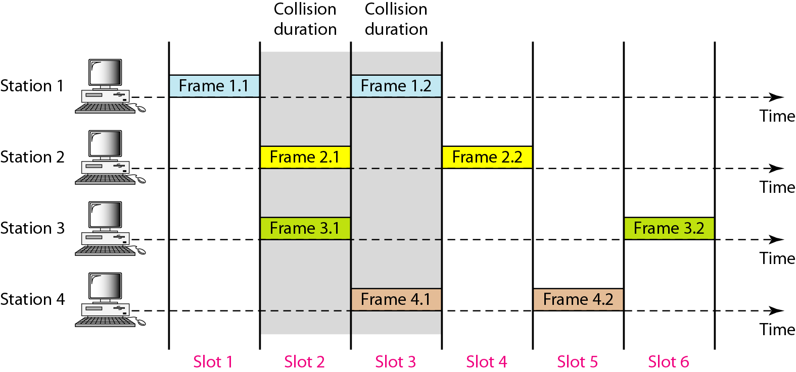
Figure 12.6 Frames in a slotted ALOHA network

Slide 11
Note
The throughput for slotted ALOHA is S = G × e^{−G} .
The maximum throughput S_{max} = 0.368 when G = 1.

Slide 12
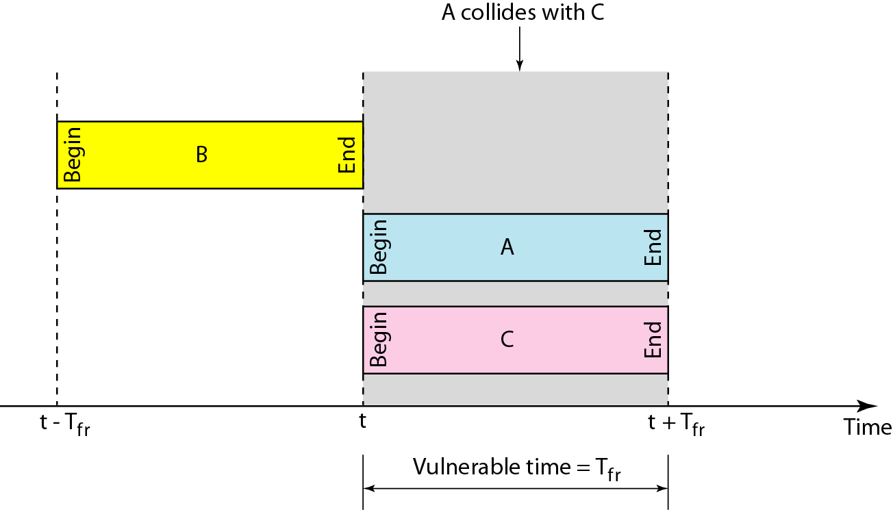
Figure 12.7 Vulnerable time for slotted ALOHA protocol

Slide 13
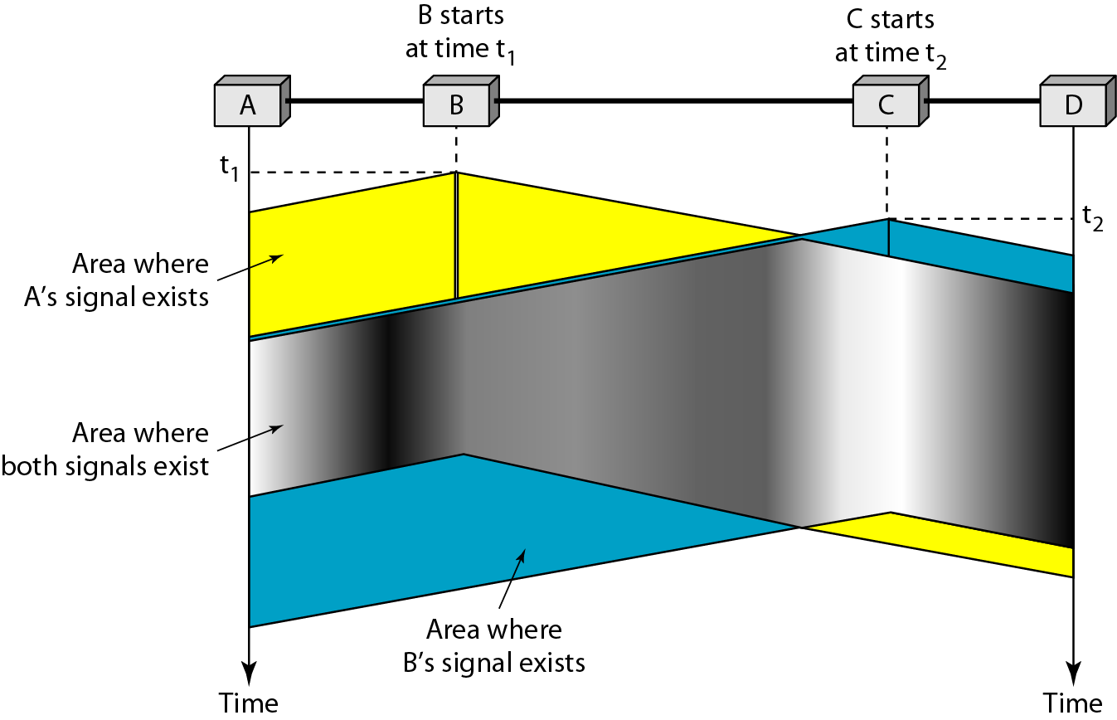
Figure 12.8 Space/time model of the collision in CSMA

Slide 14
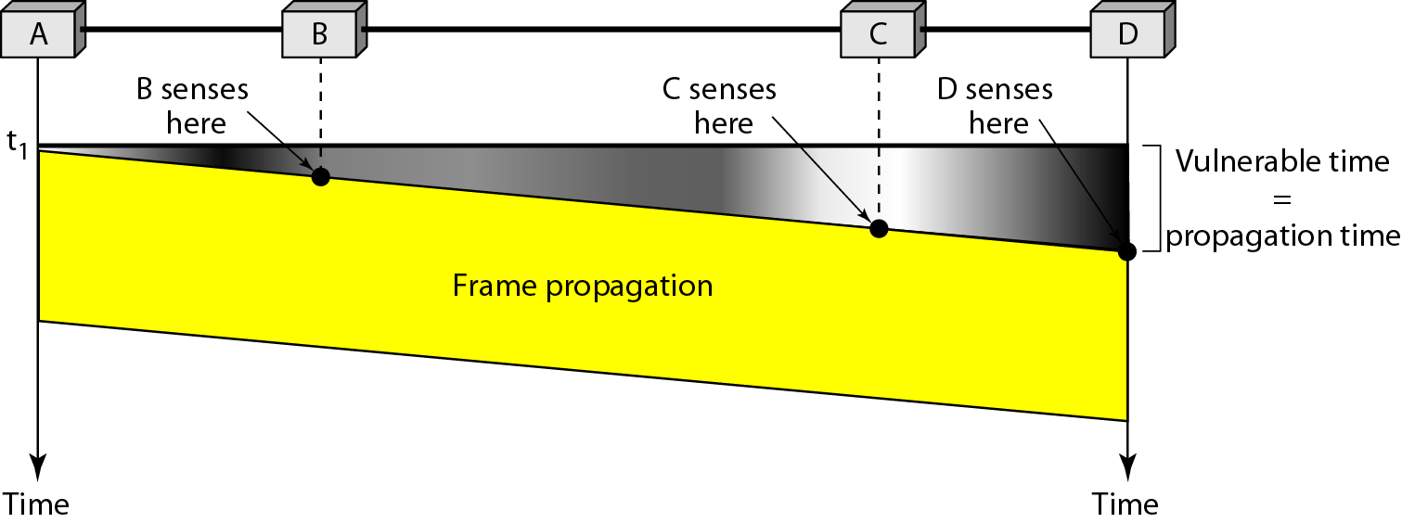
Figure 12.9 Vulnerable time in CSMA

Slide 15
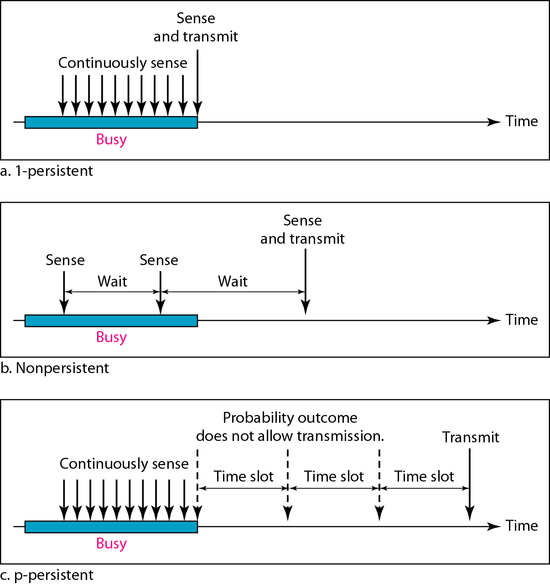
Figure 12.10 Behavior of three persistence methods

Slide 16
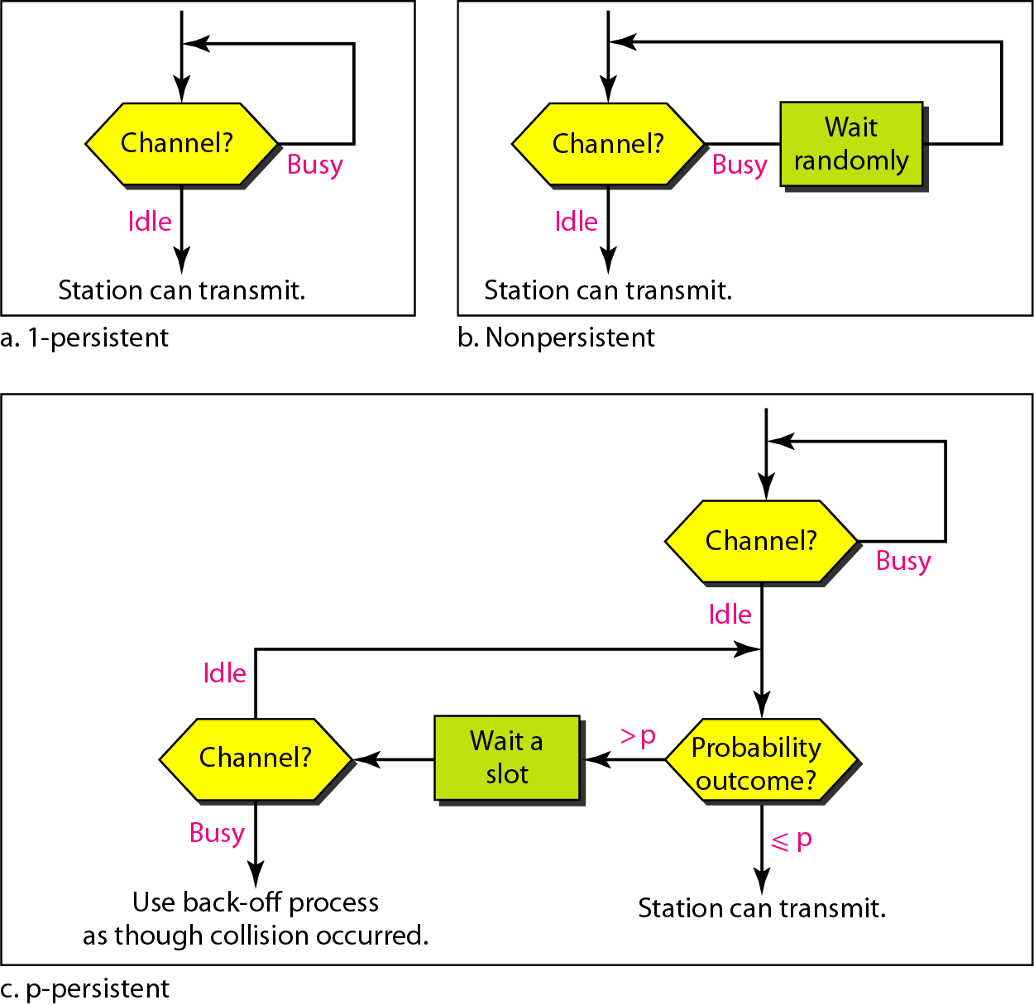
Figure 12.11 Flow diagram for three persistence methods

Slide 17
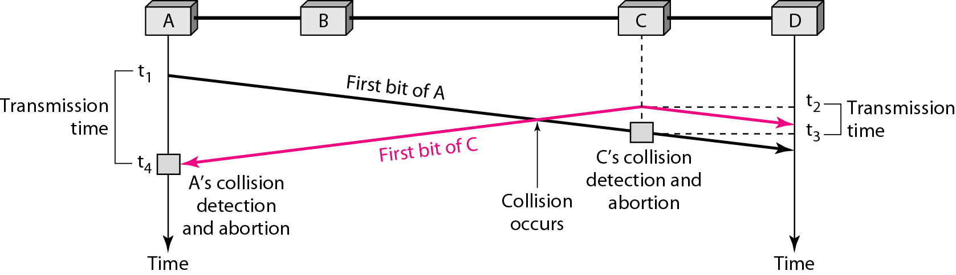
Figure 12.12 Collision of the first bit in CSMA/CD

Slide 18
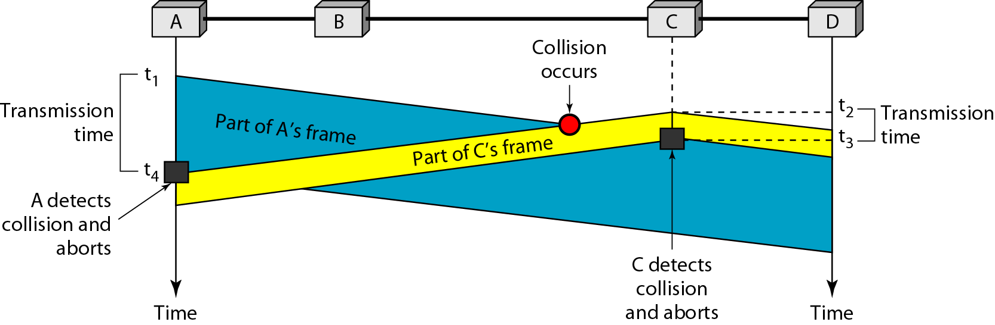
Figure 12.13 Collision and abortion in CSMA/CD

Slide 19
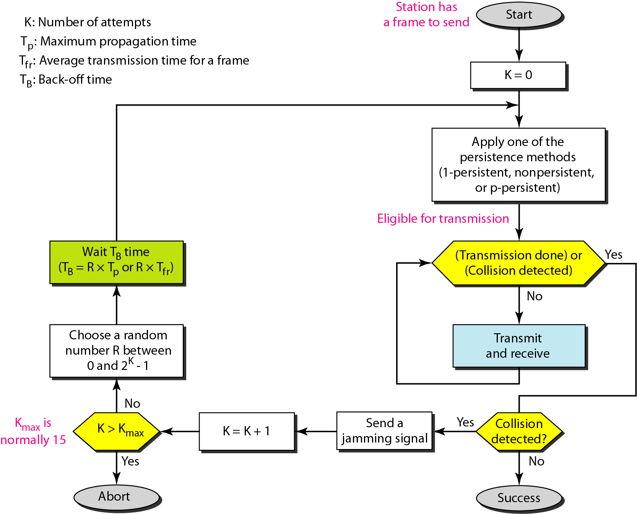
Figure 12.14 Flow diagram for the CSMA/CD

Slide 20
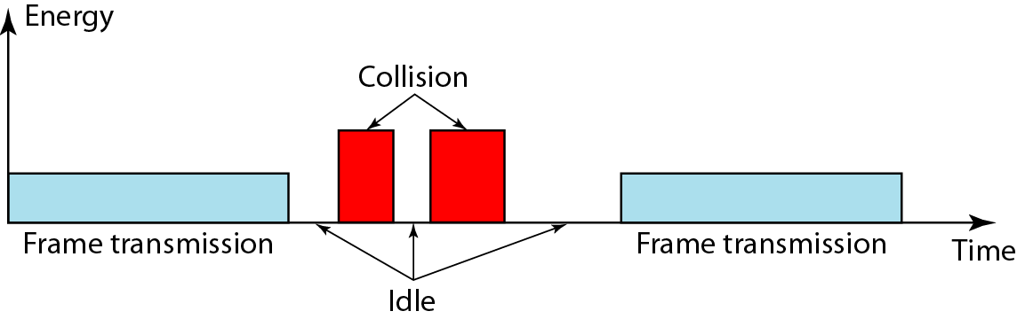
Figure 12.15 Energy level during transmission, idleness, or collision

Slide 21
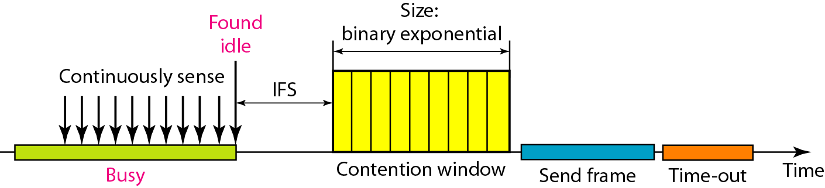
Figure 12.16 Timing in CSMA/CA

Slide 22
Note
In CSMA/CA, the IFS can also be used to define the priority of a station or a frame.

Slide 23
Note
In CSMA/CA, if the station finds the channel busy, it does not restart the timer of the contention window;
it stops the timer and restarts it when the channel becomes idle.

Slide 24
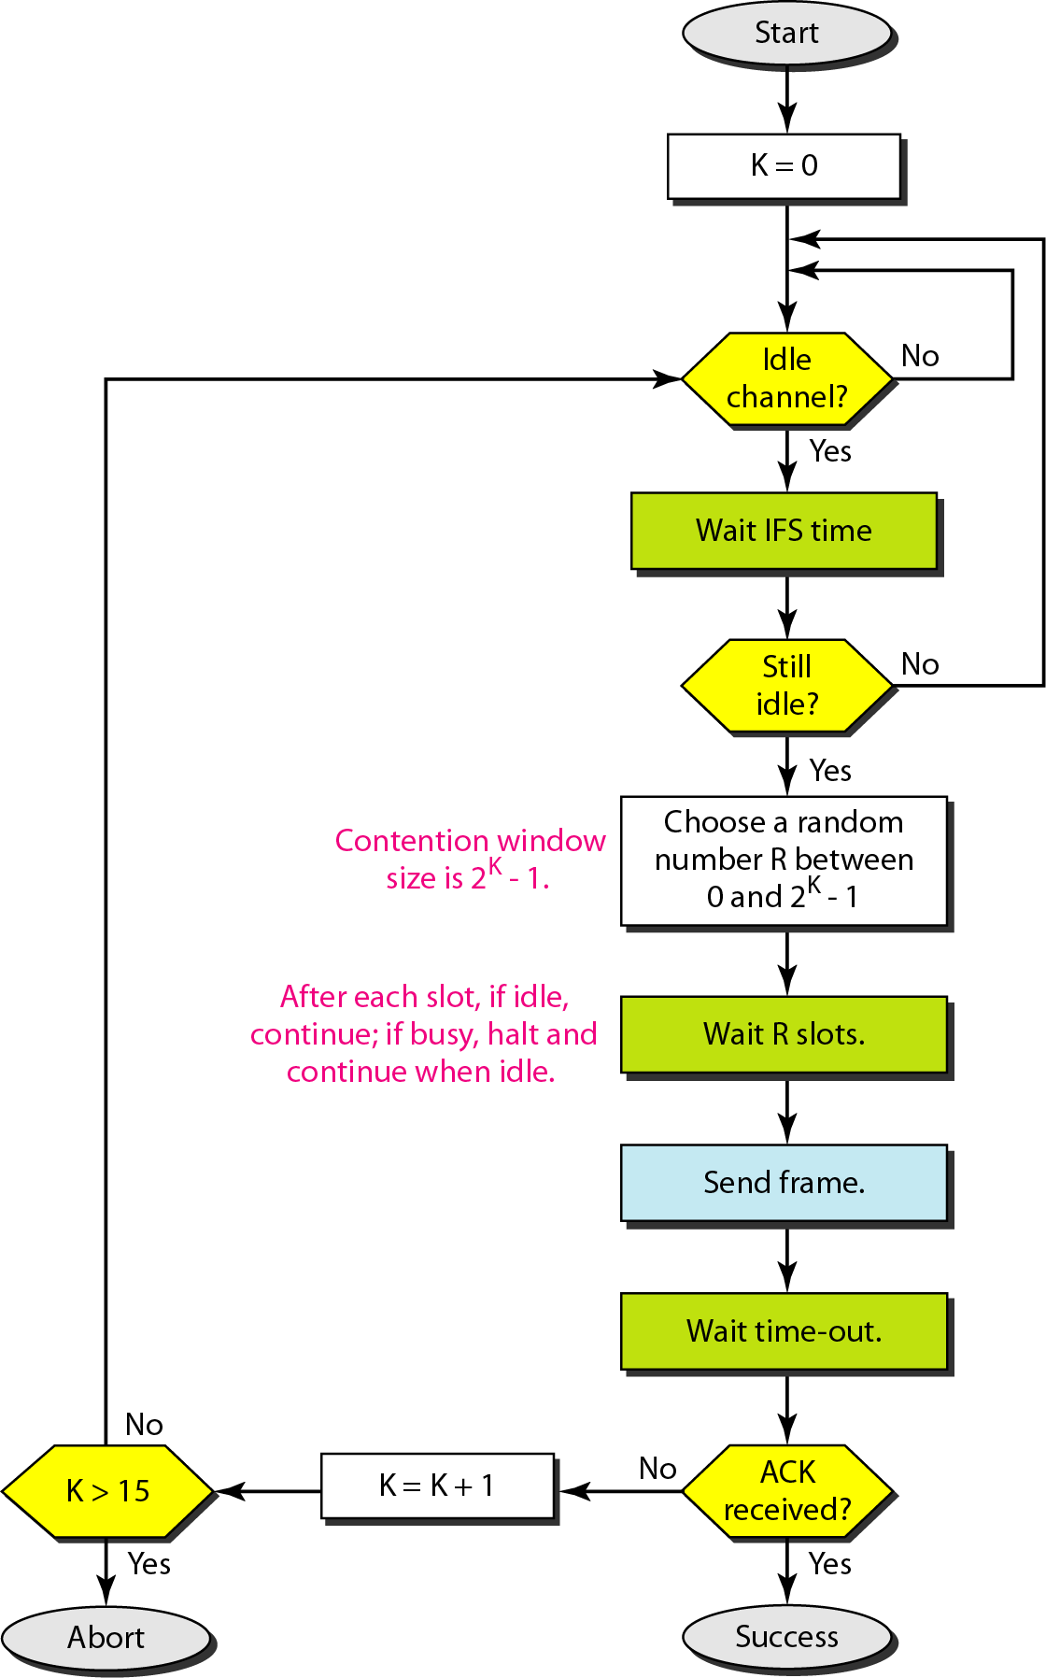
Figure 12.17 Flow diagram for CSMA/CA

Slide 25
12-2 CONTROLLED ACCESS
In controlled access, the stations consult one another to find which station has the right to send. A station cannot send unless it has been authorized by other stations. We discuss three popular controlled-access methods.
Topics discussed in this section:
Reservation Polling Token Passing

Slide 26
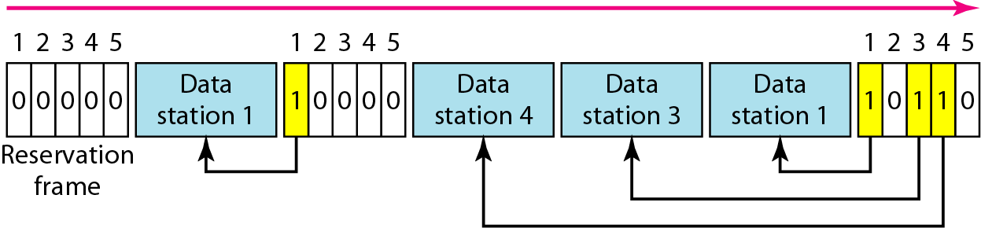
Figure 12.18 Reservation access method

Slide 27
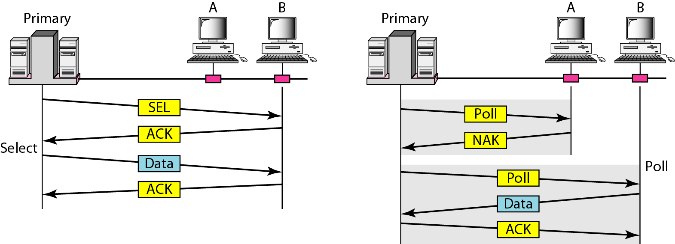
Figure 12.19 Select and poll functions in polling access method

Slide 28
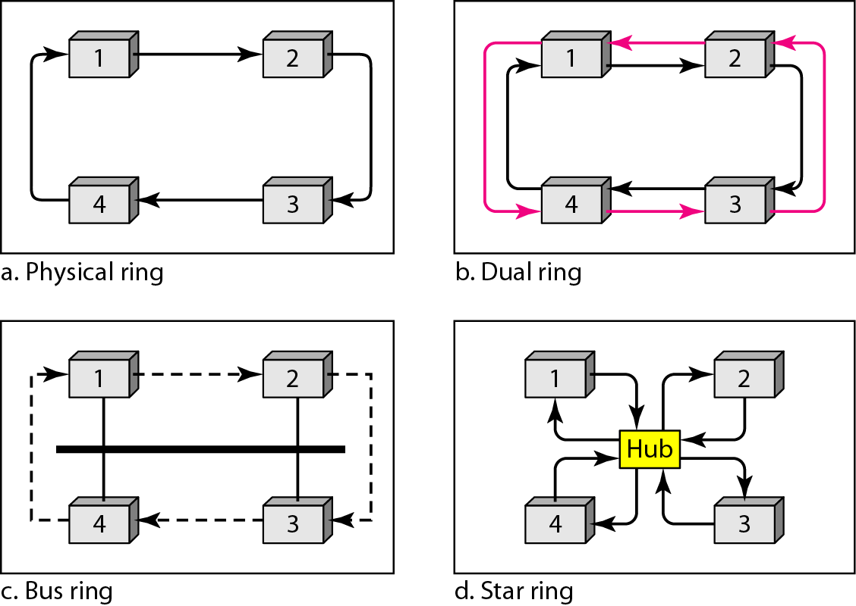
Figure 12.20 Logical ring and physical topology in token-passing access method

Slide 29
12-3 CHANNELIZATION
Channelization is a multiple-access method in which the available bandwidth of a link is shared in time, frequency, or through code, between different stations. In this section, we discuss three channelization protocols.
Topics discussed in this section:
Frequency-Division Multiple Access (FDMA) Time-Division Multiple Access (TDMA)
Code-Division Multiple Access (CDMA)

Slide 30
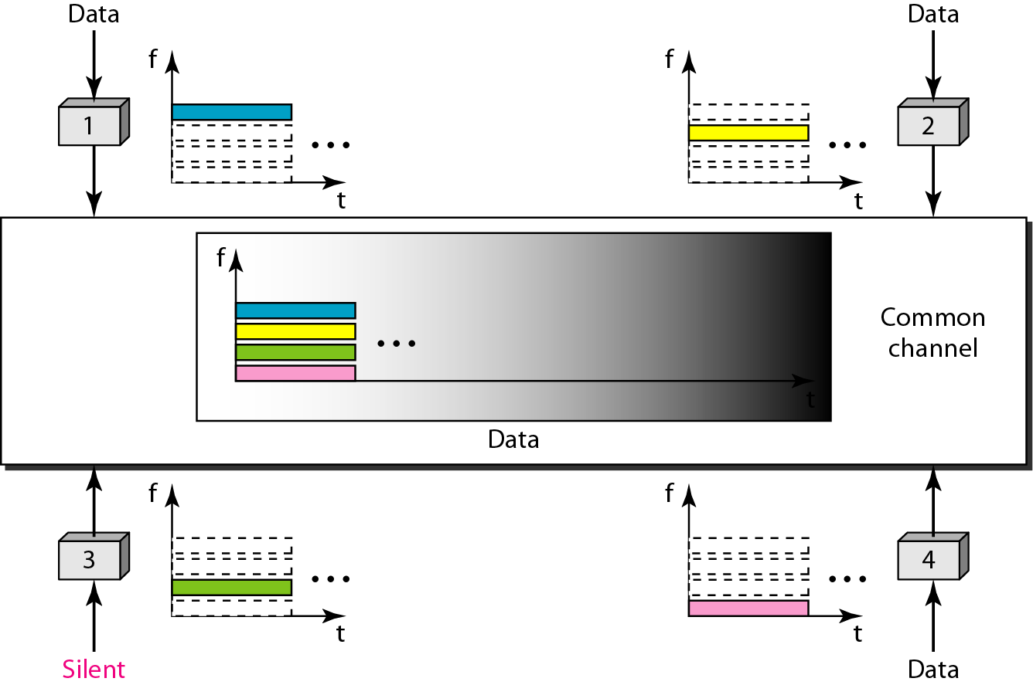
Figure 12.21 Frequency-division multiple access (FDMA)

Slide 31
Note
In FDMA, the available bandwidth of the common channel is divided into bands that are separated by guard bands.

Slide 32
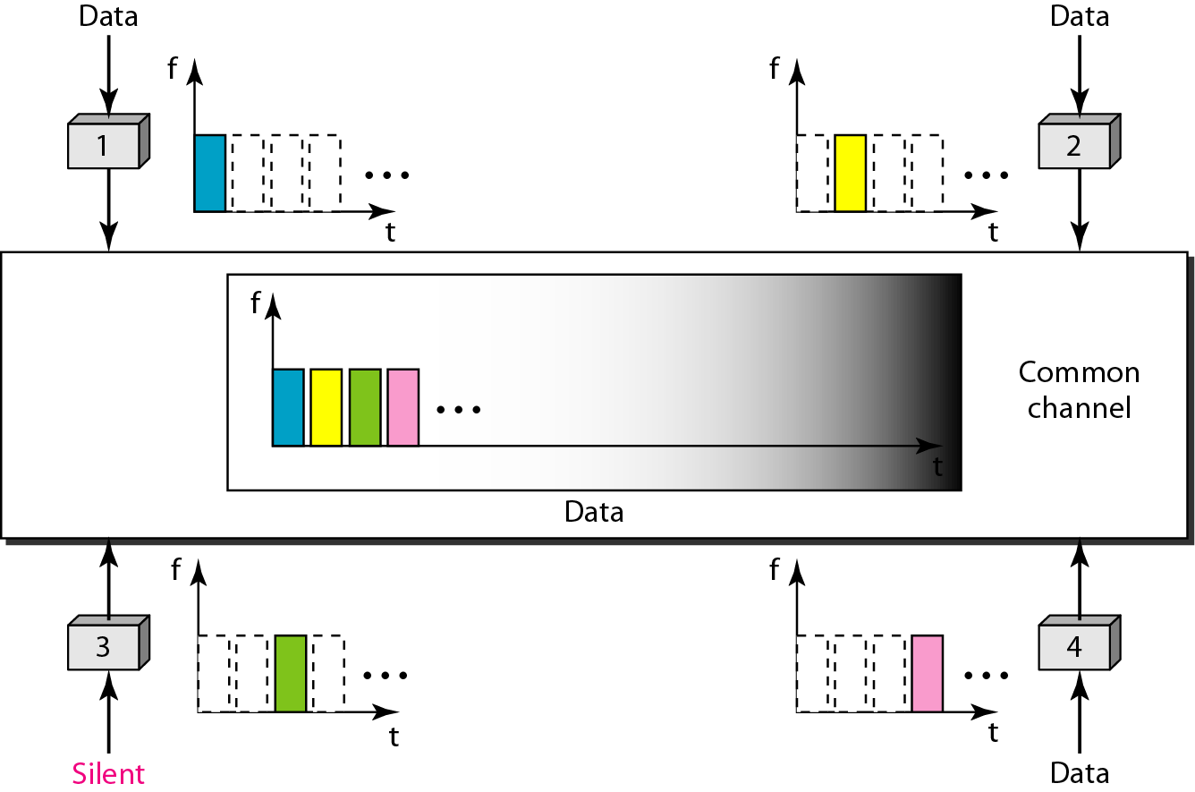
Figure 12.22 Time-division multiple access (TDMA)

Slide 33
Note
In TDMA, the bandwidth is just one channel that is timeshared between different stations.

Slide 34
Note
In CDMA, one channel carries all transmissions simultaneously.

Slide 35
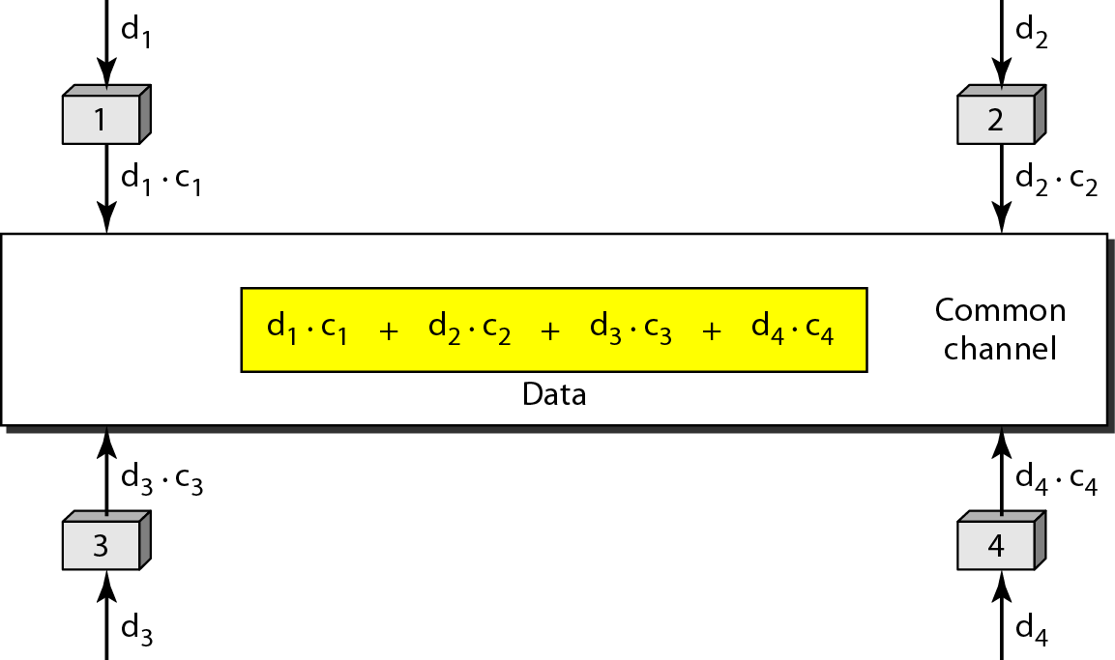
Figure 12.23 Simple idea of communication with code

Slide 36
13-2 STANDARD ETHERNET
The original Ethernet was created in 1976 at Xerox’s Palo Alto Research Center (PARC). Since then, it has gone through four generations. We briefly discuss the Standard (or traditional) Ethernet in this section.

Slide 37
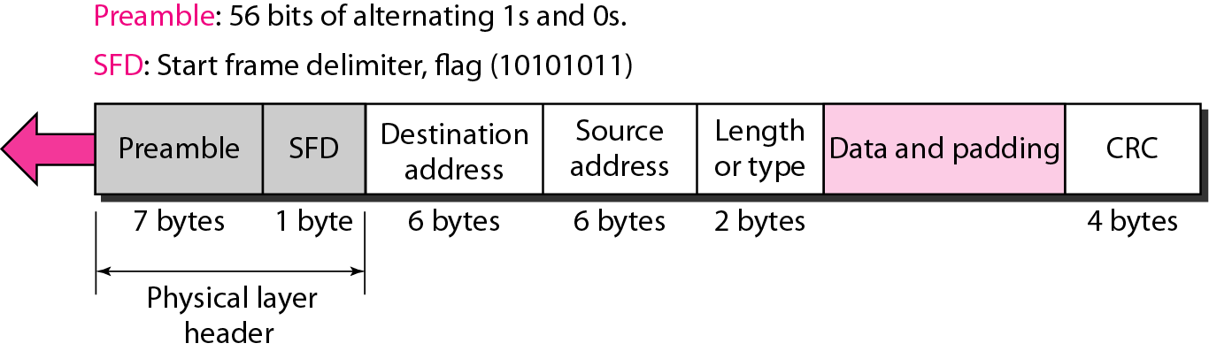
Figure 13.4 802.3 MAC frame / Ethernet frame format

Slide 38
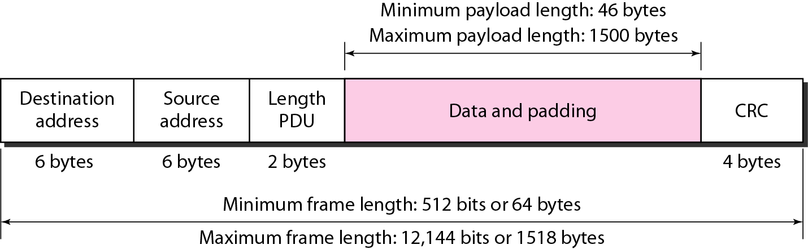
Figure 13.5 Minimum and maximum lengths

Slide 39
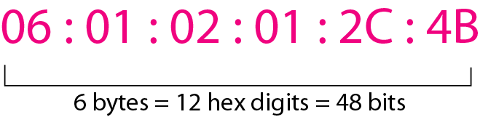
Figure 13.6 Example of an Ethernet address in hexadecimal notation

Slide 40
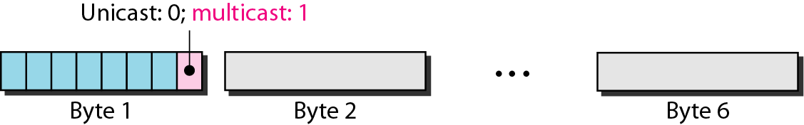
Figure 13.7 Unicast and multicast addresses
The least significant bit of the first byte defines the type of address.
If the bit is 0, the address is unicast; otherwise, it is multicast.
The broadcast destination address is a special case of the multicast address in which all bits are 1s.

Slide 41
Example 13.1
Define the type of the following destination addresses:
a. 4A:30:10:21:10:1A b. 47:20:1B:2E:08:EE
c. FF:FF:FF:FF:FF:FF
Solution
To find the type of the address, we need to look at the second hexadecimal digit from the left. If it is even, the address is unicast. If it is odd, the address is multicast. If all digits are F’s, the address is broadcast. Therefore, we have the following:
a. This is a unicast address because A in binary is 1010.
b. This is a multicast address because 7 in binary is 0111.
c. This is a broadcast address because all digits are F’s.

Slide 42
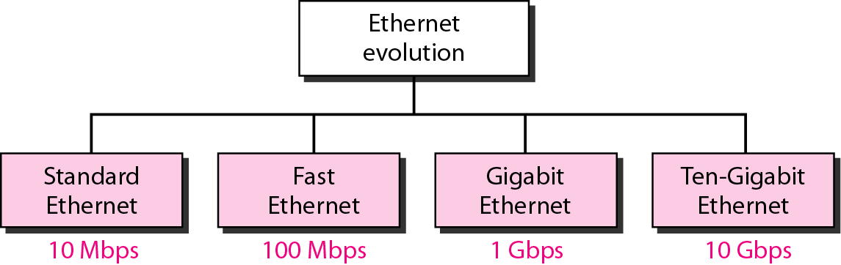
Figure 13.3 Ethernet evolution through four generations

Slide 43
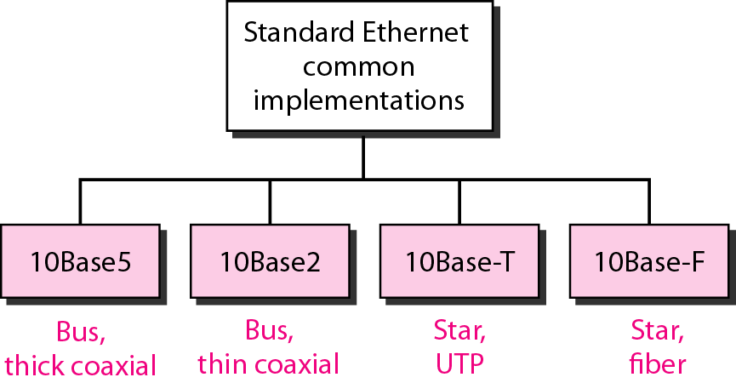
Figure 13.8 Categories of Standard Ethernet

Slide 44
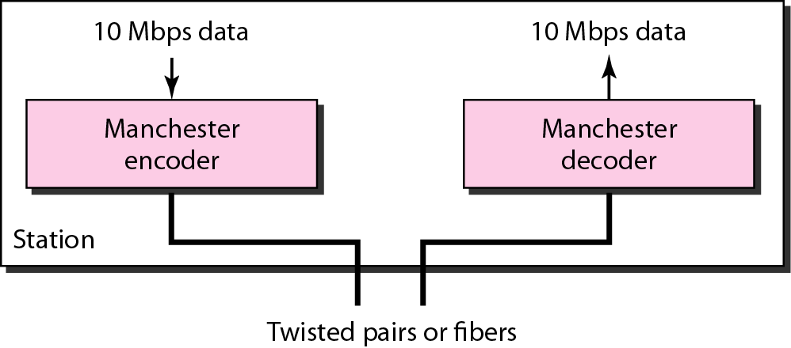
Figure 13.9 Encoding in a Standard Ethernet implementation

Slide 45
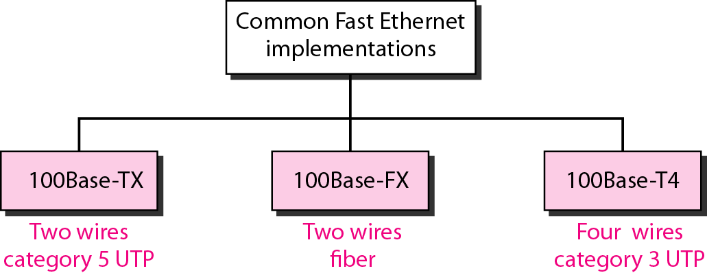
Figure 13.20 Fast Ethernet implementations

Slide 46
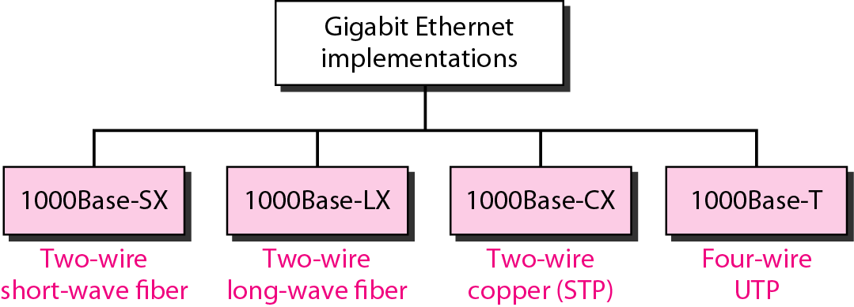
Figure 13.23 Gigabit Ethernet implementations

Slide 47
Ethernet Evolution
Standard Ethernet
Fast Ethernet
Gigabit Ethernet
Ten-Gigabit Ethernet
10 base 5
10 base 2
10 base-T
10 base-F
100 base-TX
100 base-FX
100 base-T4
1000 base-SX
1000 base-LX
1000 base-CX
1000 base-T
10GBase-S
10GBase-L
10GBase-E

Slide 48
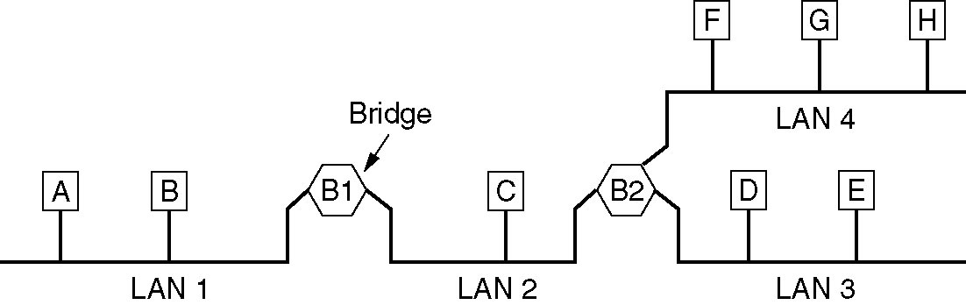
Local Internetworking
A configuration with four LANs and two bridges.

Slide 49
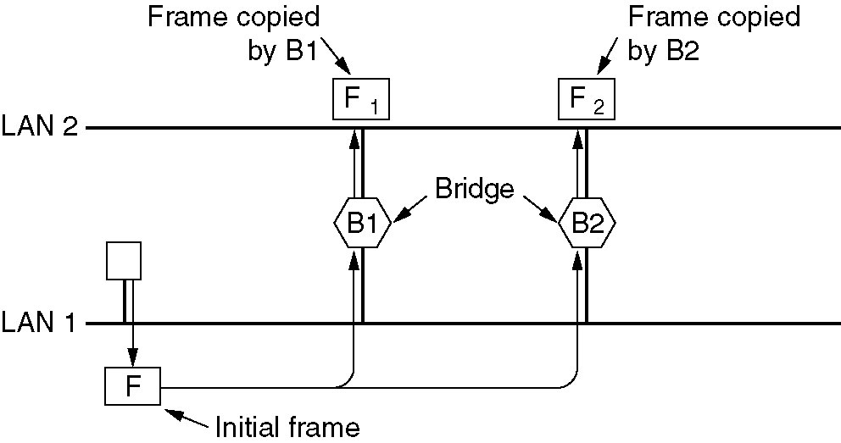
Spanning Tree Bridges
Two parallel transparent bridges.

Slide 50
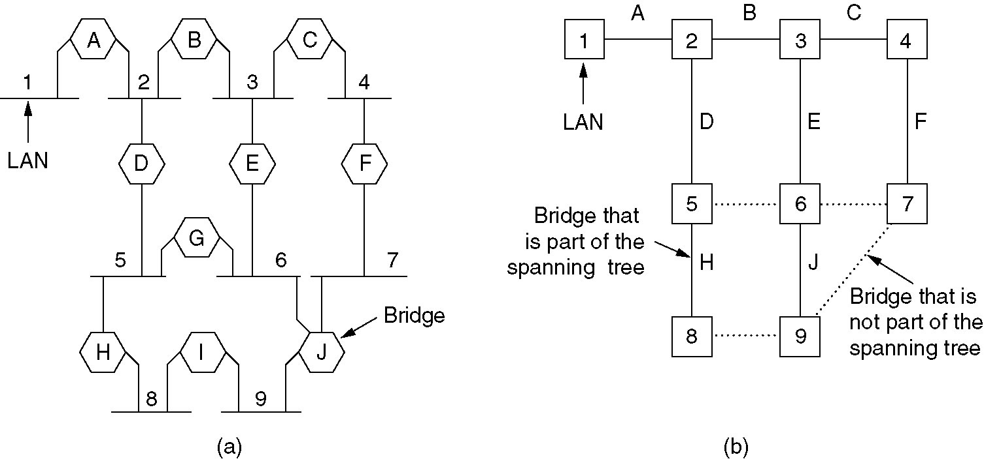
Spanning Tree Bridges (2)
(a) Interconnected LANs. (b) A spanning tree covering the LANs. The dotted lines are not part of the spanning tree.

Slide 51
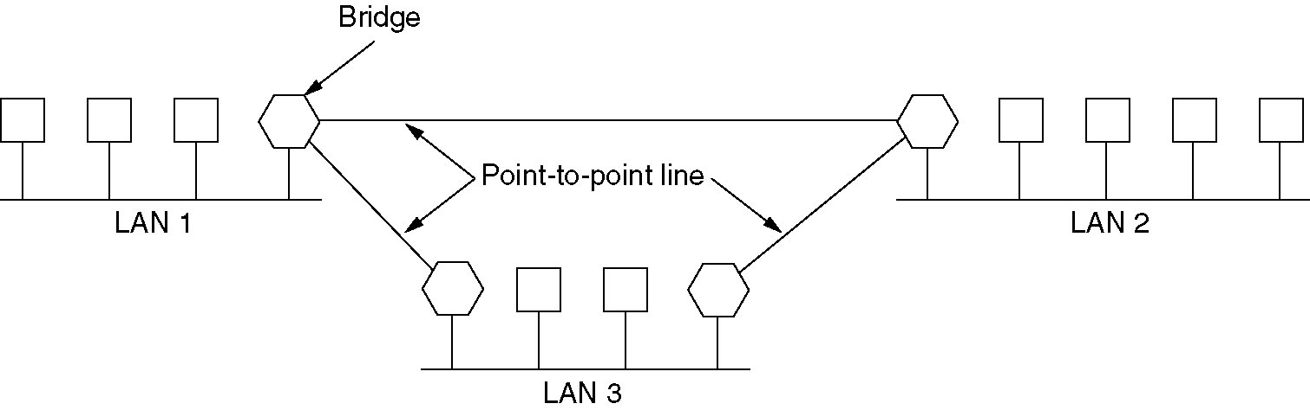
Remote Bridges
Remote bridges can be used to interconnect distant LANs.

Slide 52
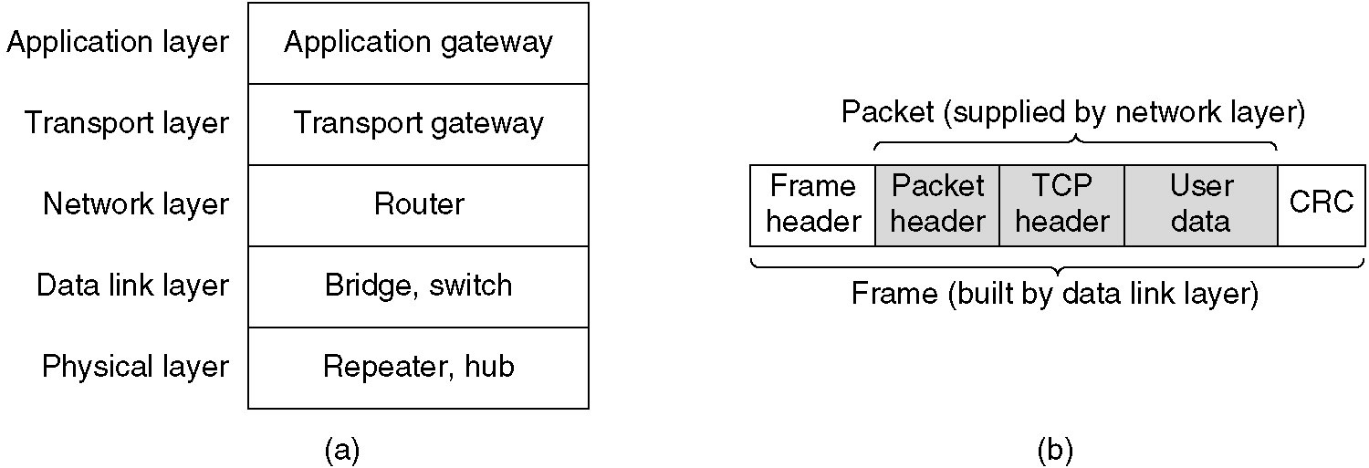
Repeaters, Hubs, Bridges, Switches, Routers and Gateways
(a) Which device is in which layer.
(b) Frames, packets, and headers.

Slide 53
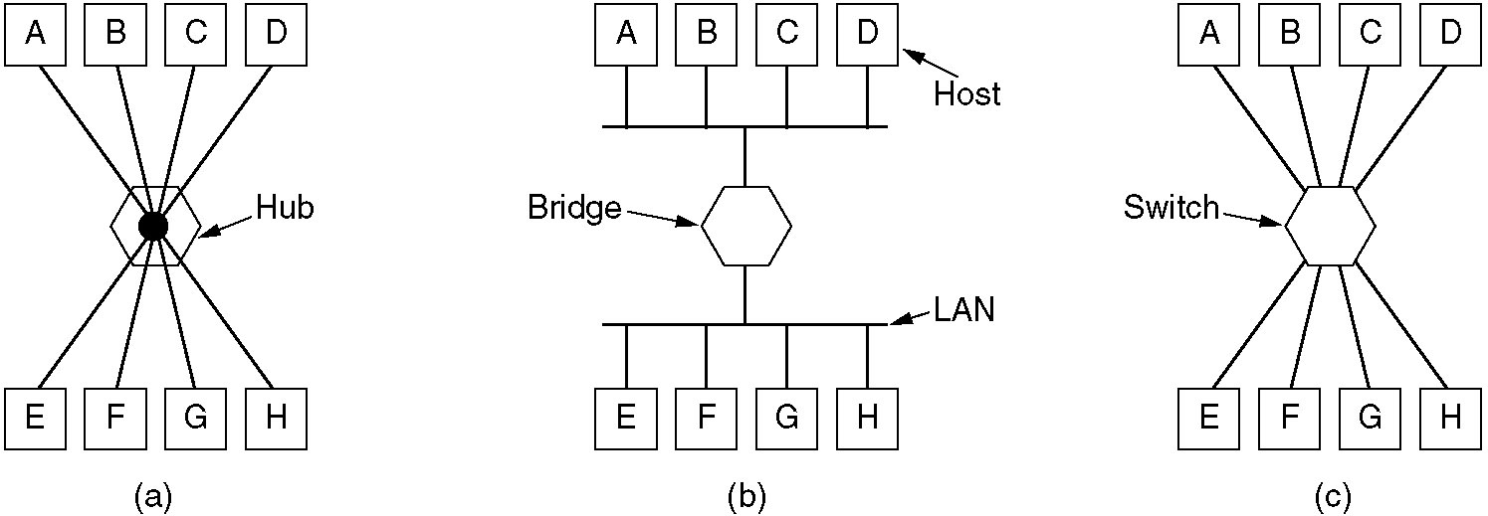
Repeaters, Hubs, Bridges, Switches, Routers and Gateways (2)
(a) A hub. (b) A bridge. (c) a switch.

Slide 54
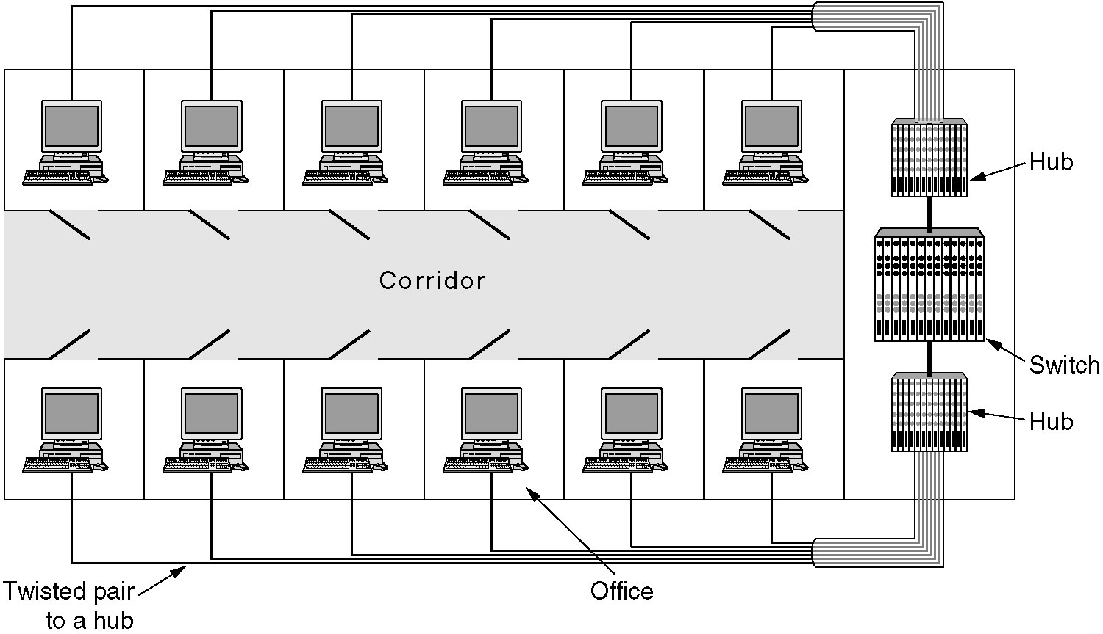
Virtual LANs
A building with centralized wiring using hubs and a switch.

Slide 55
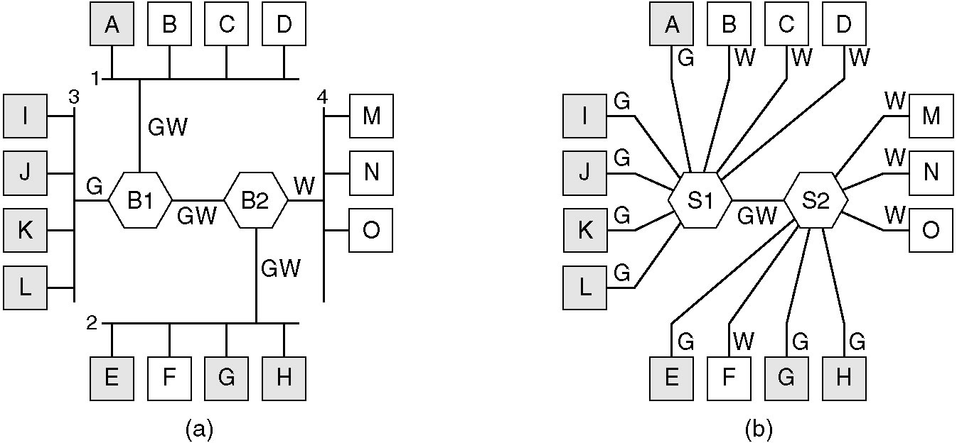
Virtual LANs (2)
(a) Four physical LANs organized into two VLANs, gray and white, by two bridges. (b) The same 15 machines organized into two VLANs by switches.

